Slide 1
Student Support and Advice
Fiona Fall, MA
Head of Student Services
Bryan Jones
Head of Disability Support

Slide 2
Advice via student’s programme and school
Academic staff, programme and module leaders for questions about the curriculum, content, tutorials, feedback, assessment
School Student Offices for support staff – quick enquiry/confidential advice - who will advise on progression, deferrals, rescheduling studies, change of mode, withdrawal, module options, change of module, programme (rare!), placements, exchange + refer to others

Slide 3
Other services
Student Services: Student Welfare Advice Team (also immigration and visas); Careers (also part-time jobs); Disability Support; Counselling (home sickness to working in groups)
See http://unihub.mdx.ac.uk/ for examples of services covered
Academic Writing and Language – free 1:1 support on academic language, structure of essays, referencing + workshops; student Learning Advisers (Learning Lounge)
Sports, nurseries, accommodation, catering
Students’ Union, Learning Resources – computing and subject support
International Student liaison and social programme (theatre, trips)

Slide 4
Academic
Registrar
Colin Davis
STUDENT SERVICES
ORGANISATIONAL CHART
November 2011
Deputy
Student Services
Fiona Fall
Fiona Fall
Deputy
Student
Information
Ian O’Donnell
Careers
Service
Julian Rhys-Williams
Counselling Services
Vacancy
Disability
Support
Bryan Jones
Welfare
Geraldine Bailey
Secretariat
Manminder Rayit
Lisa Cross
Assessment & conferments
Kelly Speller
Student Exchange and Study Abroad
Sophie Ball
Data and Management information
Paul Kevill
Sue Littlefair
Jo Wolff
Astrid Katcharyan
Melody Goh
Amanda Brace
Claire Yates
Alice Achol
Rosetta Lee
Diana Taylor
Sandra Primack
Caroline Hallett
Bernard Shapley
Sandra Taylor
Kate Medlin
Simone Gold
Marie Hayes
Simone Bhangoo
Sobia Hussain
Claire Mitham
Chris Vassiliades
Julie Roberts
Kevin Ward
Jude Cringle
Chloe Berman
Christine Struwe
MISIS Hub
Kerry Penn
Student Records,
Fin Support
Carole Fairclough

Slide 5
Overview of student experience, student communications, network with front line staff, student complaints and disciplinaries at formal level, liaise with Students’ Union, Unihub content
Counselling services: emotional problems causing study blocks; homesickness; depression; drop-in, one to one (normally 3), workshops
Disability support: assist students in levelling the playing field; advocate for student
Welfare : practical advice re money, visas, accommodation, work, legal matters, see Rough Cuts on student portal
Visas and immigration advice
Careers advisory service: Part-time jobs, graduate and postgraduate guidance; help with interviewing skills, advice on post study work, job seeking, career fairs, CV workshops

Slide 6
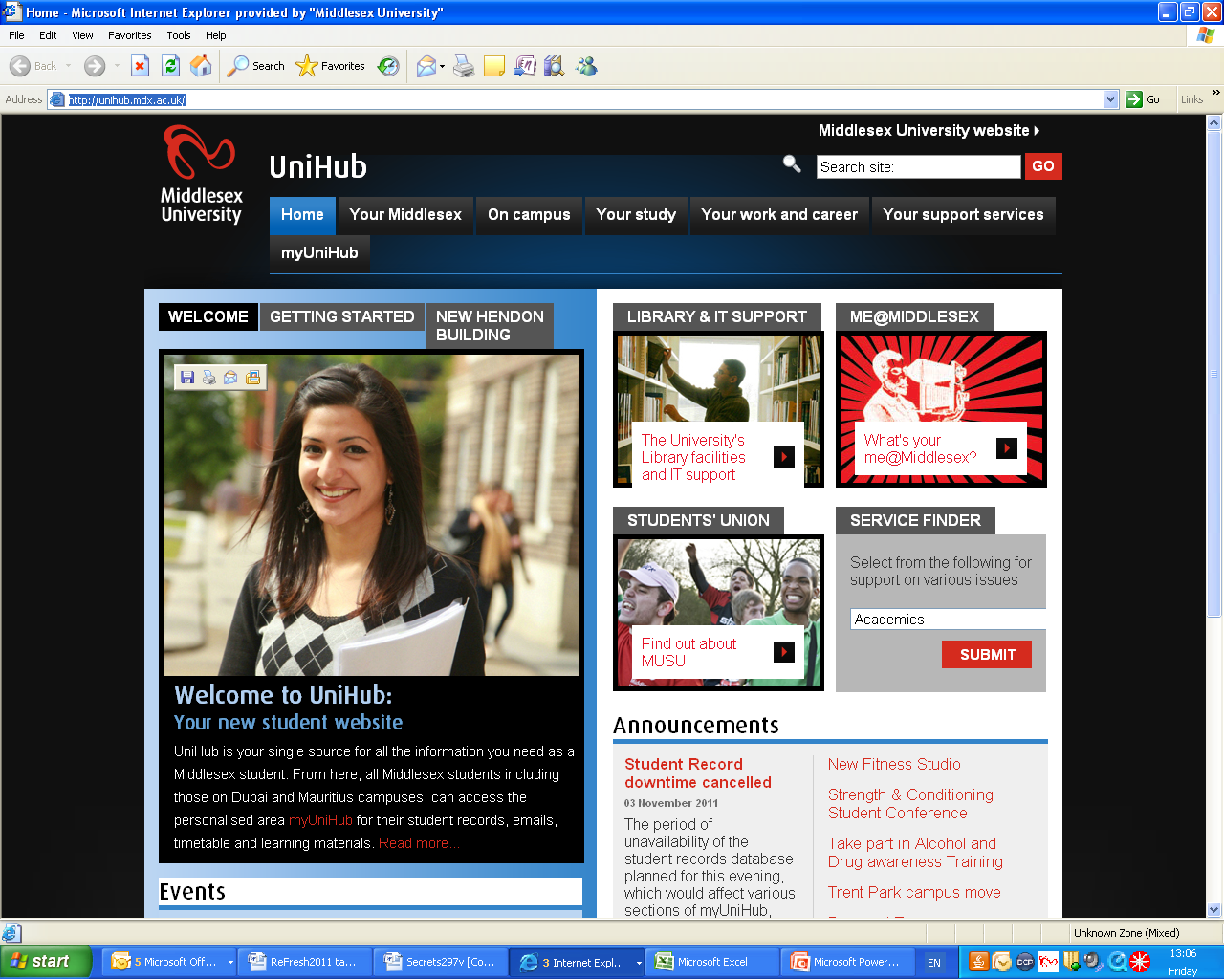

Slide 7
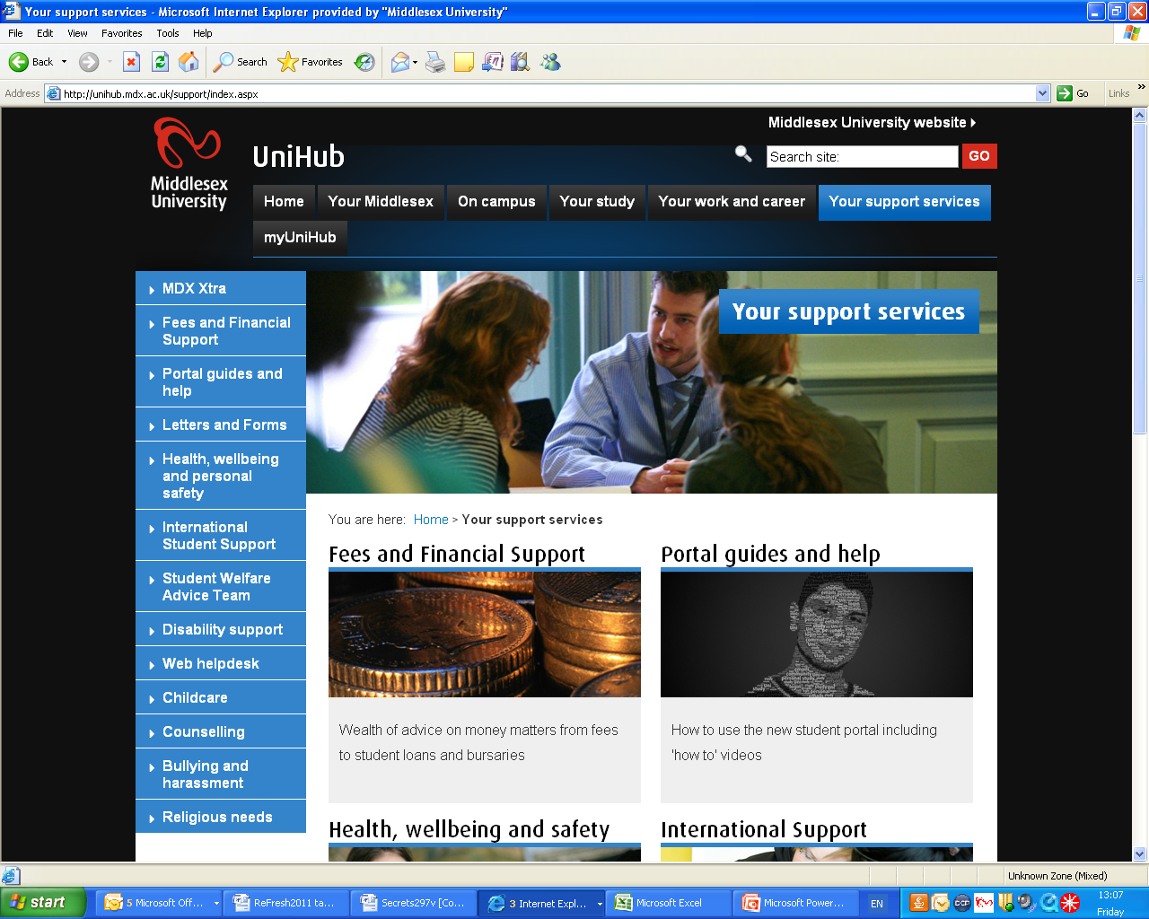

Slide 8
Any questions?

